Slide 1



Page 01
Telecom Industry
Impact Analysis of 5G Launch On
Next Slide

Slide 2

Objectives Of
This Analysis
Page 2
Evaluate the impact of the 5G launch on user and revenue trends
Identify underperforming and top-performing plans
Understand regional performance shifts (city-wise)
Analyze user churn behavior and ARPU movement
Provide actionable strategy recommendations

Slide 3
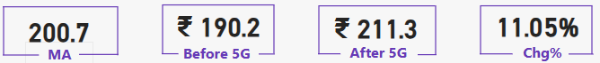
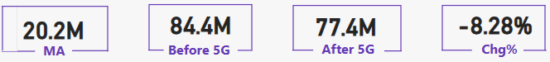
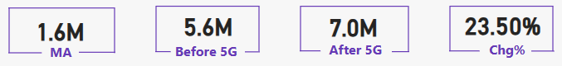
KPI Performance
Analysis
Page 3
Average Revenue Per User (ARPU)
1
ARPU by 11%
1
Total Average User (TAU)
2
TAU by 8.28%
Total Unsubscribed User (TUsU)
3
TUsU by 23.50%

Slide 4
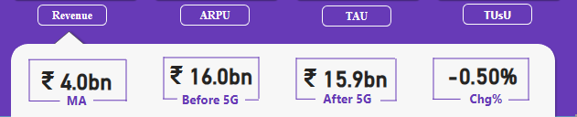
Impact of 5G
On Revenue
Page 4
Revenue
Before 5G
After 5G
Key Insights
Revenue dropped marginally by 0.50% post 5G
No major month-over-month fluctuations observed

Slide 5




Market Share
Pre & Post 5G
Page 5
📉
Market share dropped by 5.8% post-5G despite stable revenue
⚠️
Lowest share in Sept (17.8%) → rising competition
🔍
Time to evaluate competitor strategies & improve positioning
Before 5G
After 5G

Slide 6
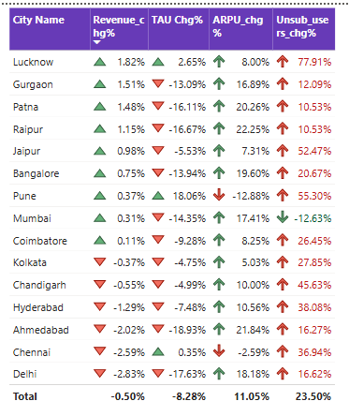
Understanding the Gaps in KPI % Changes
Why Percentages Alone Can Mislead
Page 6
⚠️ % Change can mislead when base value is small
E.g., Lucknow showed +77% churn, but actual user loss was ~130K only, which is compensated by +2% (~90K) increase in TAU
1
2
📊 Revenue % change (~0.5%) is small, but market share fell ~5%
Implies that relative performance matters more than just revenue figures
3
📌 TAU dropped by ~7M, but TUsU increased by only ~1.4M
This gap suggests dormant users or temporary inactivity
4
🧠 Users switching silently or staying inactive (without unsubscribing) are not captured in current visuals
5
✅ Real-world behavior like maintaining secondary SIMs without usage may cause this invisible churn effect

Slide 7

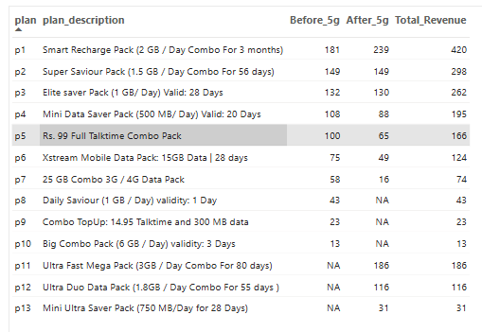



Plan Performance
Pre & Post 5G
Page 7
Plan 7 revenue dropped by 72%
Plan 5 & 6 revenue dropped by 35%
Plan 1 & 11 alone Contributed 40% of total Revenue post 5G

Slide 8
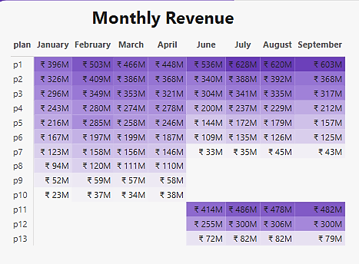

Plan Discontinued
Pre & Post 5G
Page 8
Post 5G Plans P8, P9 & P10 were discontinued (low validity, limited data)
On the other hand the new plans (P11 - P13) post 5G are outperforming the old Plans
Discontinued Plans
New Plans

Slide 9
Actionable Strategy Based on
Page 9
Post 5G Insights
🔧 Plans & Pricing
🌍 City-Level Actions
👥 User Engagement
✅ Retain and Promote Plans P1 & P11 → Consistently high revenue post-5G; ideal for core user base.
🔍 Focus retention strategies on Ahmedabad & Chennai → High churn + low ARPU → Targeted campaigns needed.
🚨 Track Dormant Users Separately from Churners → Big TAU drop ≠ pure churn. Identify reactivation opportunities.
⚠️ Redesign or Discontinue Plans P5–P7 → Sharp revenue decline (up to 72% in P7); no clear recovery post-5G.
📈 Invest in Delhi & Mumbai → Strong ARPU growth + churn control → ready for premium upselling.
🔄 Introduce Plan Migration Support → Prevent user exit by encouraging smart switching instead of leaving.
⚠️ 💡 Introduce a Mid-Tier Plan → Bridging gap between low-value and premium (P2 ↔ P11) could reduce churn.
📊 Review short-term spike cities like Pune → Monitor sustainability of growth and consider ARPU correction.
📈 Enhance Reporting KPIs → Track: New Joins, Reactivated Users, Dormant Base — to capture real movement.

Slide 10


Page 10
Final Takeaways
The 5G Launch: Mixed Impact
Revenue stability masks deeper threats: user loss (-7M TAU) & market share erosion (-5.8%)
Revive mid-tier plans, target dormant users in tier 1 cities like Ahmedabad/Chennai
KPI Patterns & Behavior
% changes alone can mislead — context from absolute values is crucial
High churn in some cities (like Lucknow) is exaggerated by small base effect
Dormant users, silent switchers, and non-subscribed inactivity are gaps in current visuals

Slide 11

Page 01

